Slide 1

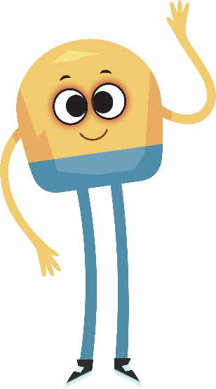

Unit 2: Week 6
Kindergarten

Slide 2
Copyright © Savvas Learning Company LLC. All Rights Reserved.
This publication is protected by copyright, and permission should be obtained from the publisher prior to any prohibited reproduction, storage in a retrieval system, or transmission in any form or by any means, electronic, mechanical, photocopying, recording, or otherwise. For information regarding permissions, request forms, and the appropriate contacts within the Savvas Learning Company Rights Management group, please send your query to:
Savvas Learning Company LLC, 15 East Midland Avenue, Paramus, NJ 07652
or
k12learningpermissions@savvas.com
myView Literacy® is an exclusive trademark of Savvas Learning Company LLC in the U.S. and/or other countries.

Slide 3

Lesson 1

Slide 4
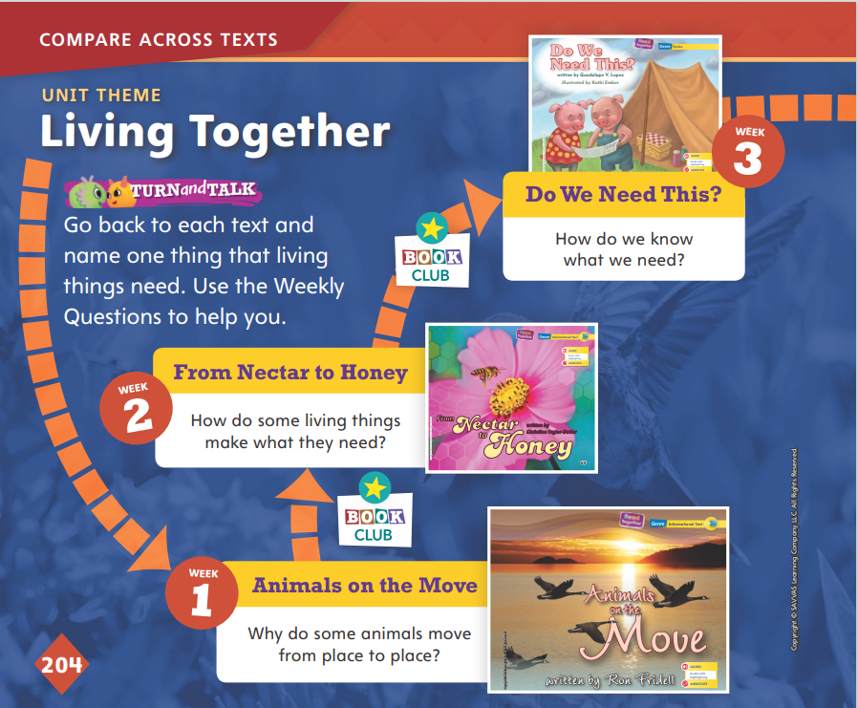
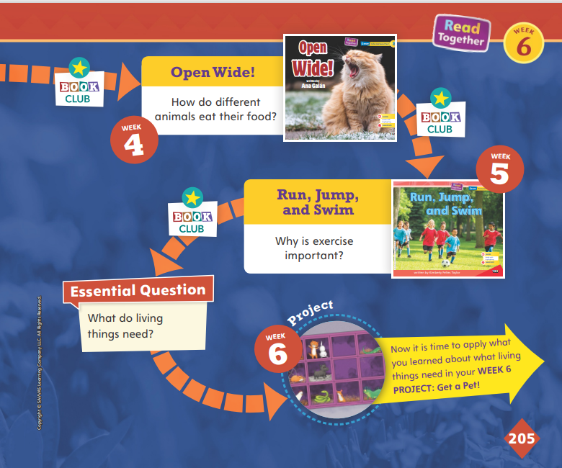

Page
204, 205
Compare Across Texts
Go back to each text and name one thing that living things need.
Notes:
In this unit, students have read about living things and what they need. Remind them of the unit theme, Living Together, and the Essential Question: What do living things need?
In pairs, have students look back at each text and find a sentence or picture that helped them answer the Essential Question.

Slide 5
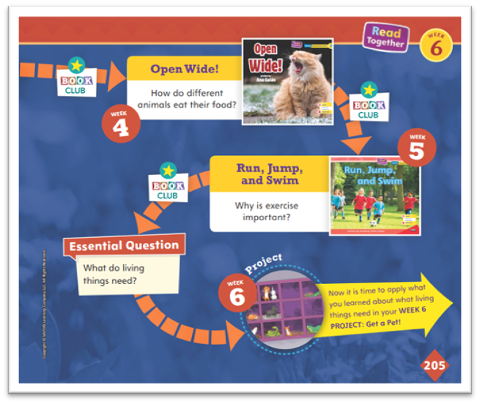

Page
204, 205
Compare Across Texts
What do living things need?
Write or Draw your answer.
Notes:
Remind students that all of the selections in this unit are connected by the unit theme, Living Together. Then use the questions below to help students compare themes, topics, and genres across texts.
Say: In the text Animals on the Move, we read that animals move to get away from cold weather or to find food. In Run, Jump, and Swim, we read that people move. Why do people move? (Possible response: People move to stay healthy or for fun.)
Ask: What does the author of Run, Jump, and Swim want readers like us to do? (Possible response: Exercise, play, and move.)
Say: The text Open Wide! is about living things. When we look at the pictures, we see real animals. This text tells about something real. It is an informational text. The text Do We Need This? is also about living things. Look at the pictures. Is this text about something real? Guide students to say that it is not real. It is fiction.
Have students write or draw their responses to the Essential Question: What do living things need? Tell students to look back at the texts that they have read in this unit to help them answer the question. Then tell students that this week they will work on a project in which they choose a pet and research its needs.

Slide 6

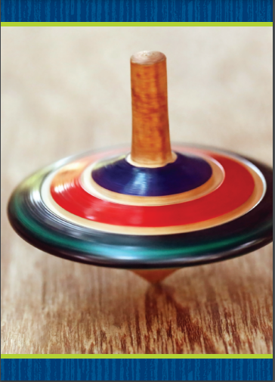
Phonological Awareness
Notes:
Tell students that today they will listen for and say words that rhyme. Rhyming words have the same middle and ending sounds, like the words cot and hot.
Display Picture Card mop. This is a picture of a mop. Listen to the sounds in mop: /m/ /o/ /p/. What sound do you hear in the middle of mop? What sound do you hear at the end? Students should say /o/, /p/.
Then hold up Picture Card top. Say: This is a picture of a top. Top rhymes with mop. When words rhyme, it means they have the same middle and ending sounds. Top and mop have the sound /o/ in the middle, and the sound /p/ at the end. What other words can you think of that rhyme with top and mop? Possible responses are cop, hop, pop, stop, and drop.
Continue the activity with other rhyming words, such as job, sob, and cob.

Slide 7
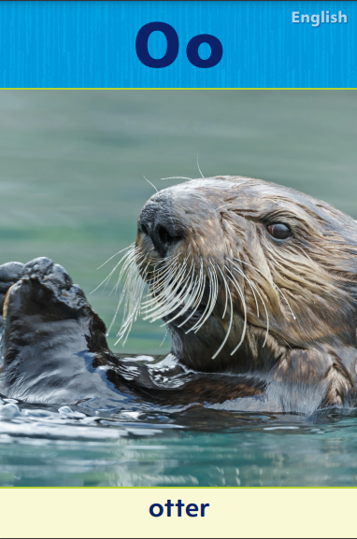
Phonics
pot
lot
cot
nod
rod
Notes:
Display Alphabet Card Oo, and point to the picture of the otter. What sound do you hear at the beginning of otter? Students should identify the sound /o/. We already learned about the letters that spell the sound /o/. Point to the letters Oo. What letters can make the sound /o/? (Oo)
Display the word pot. Point to each letter as you say each sound: /p/ /o/ /t/. When I blend the sounds of these letters together, I read the word pot. Say the sounds with me: /p/ /o/ /t/.
Model blending the word together. Then display the words lot, cot, nod, and rod. Point to the letters in lot and have students identify each sound. Then have students blend the sounds in the word to read it.
Repeat with the words cot, nod, and rod.
Have partners take turns reading the words that have been displayed.

Slide 8
High-Frequency Words
blue
what
green
Notes:
Write the high-frequency words blue, what, and green.
Show students familiar letter sounds, such as b/b/ and l/l/, in these words.
Point to the word blue and read it.
Have students identify the word blue by pointing to it, and then have them read it.
Repeat for each word.

Slide 9
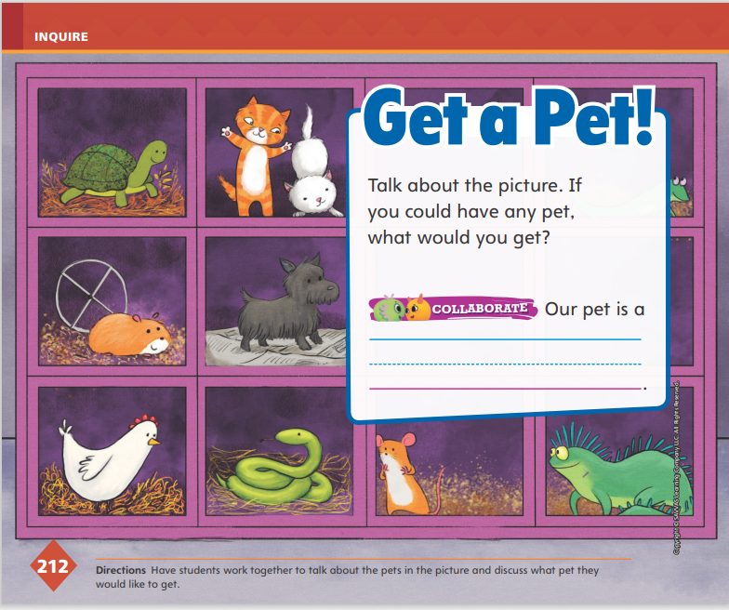

Page
212
Inquire – Introduce the Project
Talk about the picture.
If you could have any pet, what would you get?
Write your answer on the page.
Notes:
Tell students that this week they will work in pairs to choose a pet and research what it needs. Then they will write an informational text about their pet. Remind students of what they learned in Unit 1 about developing a research plan, and then direct their attention to the first item in the Pet Research Plan on p. 213 in the Student Interactive: Choose a pet.
Say: If I could have any pet, what would I get? While it would be nice to get a tiger or a chimpanzee, these animals are too wild and would not make good pets. I need to choose a pet that could live in my home and that I could take care of.
Ask students the following questions to help them narrow their focus: What are some pets you see in the picture? Does anyone have one of these pets? Do you think all of these pets have different needs?

Slide 10
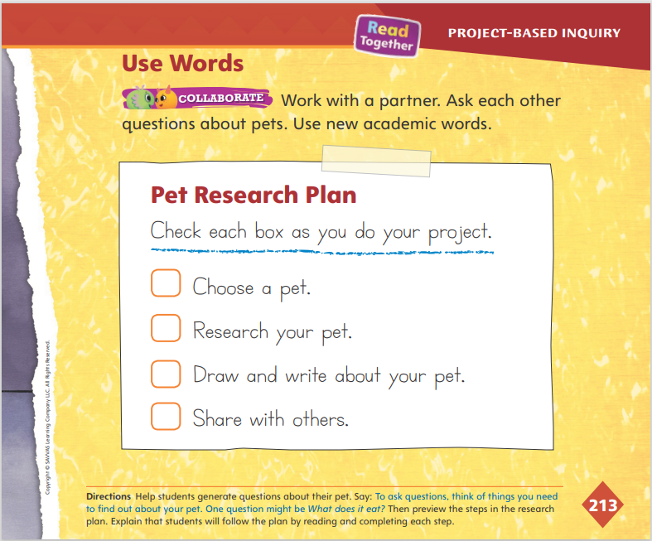
Page
213
Inquire – Introduce the Project
Turn to page 213 in your Student Interactive.
Notes:
Read through the remaining steps in the Pet Research Plan. Explain that students can follow the plan by reading and completing each step.
Then help students make the connection that an important part of doing research is asking questions. Explain that to ask questions, students should think of things they need to find out about their pet.
Also explain that their personal experience with pets is valuable and is considered part of their research.

Slide 11
Page
212, 213
Inquire – Use Words
Ask each other questions about pets using your Academic Vocabulary.
Notes:
Remind students that the academic vocabulary words they learned in this unit relate to the unit theme, Living Together.
Model using Academic Vocabulary words grow, need, share, and depend as you describe the animals pictured on p. 212. Say: I might choose a dog because dogs are dependable. Then have partners ask questions about their pet, providing assistance as needed.
For differentiated support:
Have struggling students listen as you describe the animals in the picture. Provide students with a word bank or point to the word wall of Academic Vocabulary. Ask students to help you choose an Academic Vocabulary word to talk about one of the images.
Invite students to draw a picture that shows the meaning of one of the Academic Vocabulary words. Help students label the drawing.
Next Steps: Once individual students or groups have chosen their pet, have them check off the first item in the Pet Research Plan. Tell students that now that they have chosen their pet, the next step is to follow a plan as they research what that pet needs. Explain that you will teach them how to research.

Slide 12
Lesson 2

Slide 13
Page 206
Phonics
-op | -ot
mop
hot
top
not
Notes:
Hold up Picture Card top. Say: This is a top. The beginning sound in top is /t/. That sound is spelled with the letter t. The ending sounds in top are /o/ /p/. These sounds are spelled with the letters op. Words that end with the sounds /o/ /p/, and are spelled with the letters op, are in the same word family. The word mop ends with the sounds /o/ /p/ and the letters op, so the words top and mop are in the same word family.
Display the word hot. This is the word hot. It ends with the sounds /o/ /t/, and the letters ot. Another word in the /o/ /t/ spelled ot word family is not.
Display the letter combinations -op and -ot on the board. Tell students that you will say words either in the -op or -ot families.
Tell them to listen carefully to the words, and trace op or ot in the air, depending on which ending sounds they hear in the word. Tell them that there will be one word that is not part of either the -op or -ot word families. Use the following words for this activity, emphasizing the ending sounds: top, mop, tot; cot, hot, mat; cop, drop, pot.

Slide 14
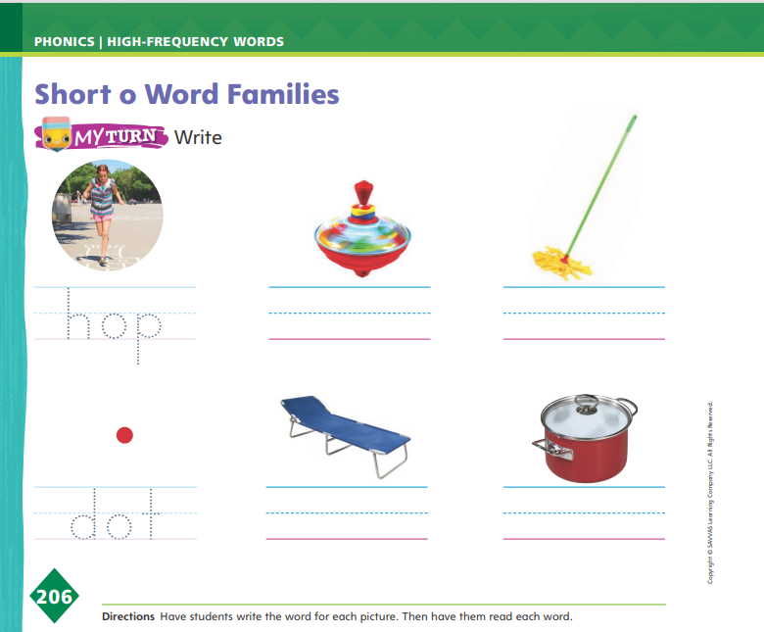
Page 206
Apply
Turn to page 206 in your Student Interactive and complete the activity.
Notes:
Have students identify each picture on p. 206 of the Student Interactive, and tell students that each word belongs to either the -op or -ot word family.
Then have them write the words on the lines. Ask students to identify the sounds of the letters that are different in each set of words.

Slide 15
High-Frequency Words
blue
what
green
Notes:
Tell students that high frequency words are words that they will hear and see over and over in texts.
Write and then read the words blue, what, and green.
Have students read the words with you and clap each letter as they spell the words.

Slide 16
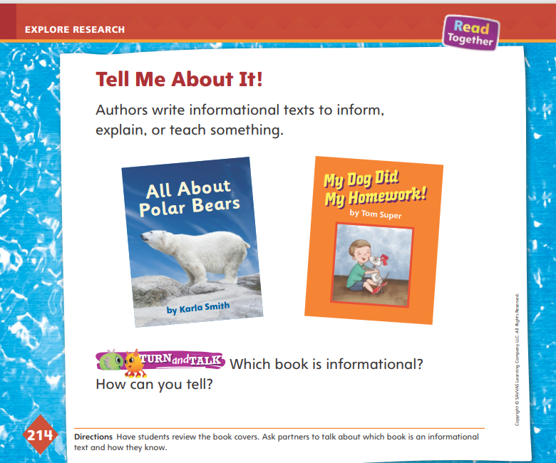
Page
214
Explore and Plan – Informational Text
Turn to page 214 in your Student Interactive.
Notes:
Have students turn to p. 214 in the Student Interactive. Explain that authors write informational texts to inform, explain, or teach something. Use the Model and Practice below to help students differentiate between informational texts and other genres. Tell them that they will write an informational text this week.
Say: In this unit we have been reading and writing informational texts. Remember that the purpose of informational texts is to explain or inform readers about a topic. An informational text is about something real. When I look at the covers of the two books, I notice that both are about animals, but that one of them is about a robot dog. Which book looks like it is about something real? Call on a student volunteer to read each title.

Slide 17
Page
214
Explore and Plan – Informational Text
Which book is informational?
How can you tell?
Notes:
Discuss with students how to infer that one of these books is nonfiction (All About Polar Bears) and one is fiction (My Dog Did My Homework!). Help students make the connection about using the title to infer a book’s topic and genre.
To help students begin to understand the structure of informational texts, do a picture walk of a nonfiction text from your classroom library. Use a text that has pictures, diagrams, and captions to teach students how the author organizes information. Read aloud and point to heads and subheads in the text to demonstrate how the text is structured. Tell students that they will have to look through these types of informational books to write about their pet.
Have students think about the audience for their writing about a pet. Offer questions to help students think about their audience, such as Who might want to know more about turtles? What do you think your classmates would want to know about your pet? Write student responses on the board. Tell students that it is always important to write with their audience in mind.
Next Steps: After reviewing the characteristics of informational writing, remind students that the next step on the Pet Research Plan is to research the pet they chose.

Slide 18
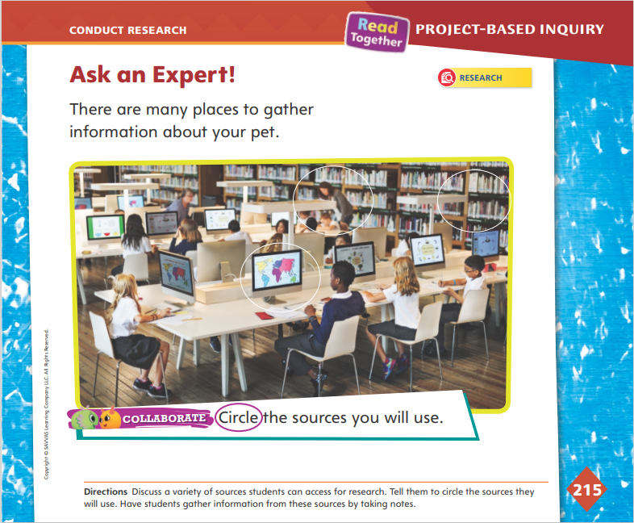
Page
215
Conduct Research
Turn to page 215 in your student interactive.
Notes:
Tell students there are many places they can gather information about their pet. Point to the picture on p. 215 in the Student Interactive and ask a student volunteer to tell what this place is (library or media center). Then use the Model and Practice to explain the process of researching an animal.
Say: The library or media center is one of the best places to gather information. Most libraries have books, magazines, and newspapers. We call these print sources because they are printed on paper, and we can hold them in our hands. Most libraries also have computers. You can use a computer to go on the Internet to search Web sites for information. If you are in a library and don’t know what kind of source to use, ask the librarian for help. Help students understand how to use a variety of sources to search for information in the library or media center.
Books in a library are organized in a special way. Books about a topic, such as animals, will be together in the same section. Each book has a special number called a call number. The call number tells you where you can find the book in the library.
Computers that are connected to the Internet are also a good source for information, but you have to be careful. Some Web sites will give you good, true information and some Web sites may not. Your librarian can help you find a Web site that will give you good, true information.
Real-life experiences can also be a good source of information.

Slide 19
Page
215
Conduct Research
Circle the sources you will use.
Notes:
Have student groups circle things that can help them gather information on p. 215.
Then have students work with their project partners to generate questions and gather information from a variety of sources to answer these questions. Guide them to take notes on information they find by writing or drawing.
For differentiated support:
Model using sentence frames to help students find information about their pets: My pet is a ____. I want to look (in a book/on the Internet) for more information about my pet.
If students easily work together to draw what they learn about their chosen topic, ask them to label their ideas with words.
When student groups have collected information about their pets, have them go back to the Pet Research Plan on p. 213 in the Student Interactive and check the box “Research your pet.” Then tell students that the next step is to start writing about their pet.

Slide 20
Lesson 3

Slide 21

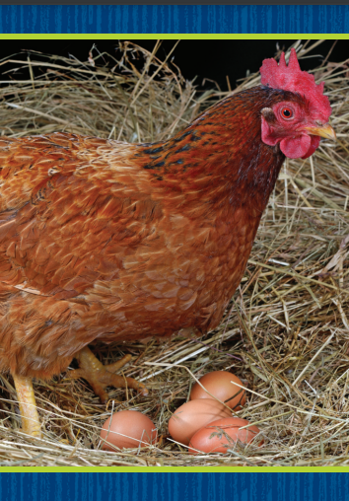
Phonological Awareness
Notes:
Tell students that today they will listen for and say words that rhyme. Remind students that rhyming words have the same middle and ending sounds, like the words hen and ten.
Display Picture Card ten. Say: This is the number ten. The first sound is /t/. The middle and ending sounds are /e/ /n/.
Then hold up Picture Card hen. Say: This is a picture of a hen. Hen rhymes with ten. They both have the sound /e/ in the middle and the sound /n/ at the end. What other words can you think of that rhyme with ten and hen? Possible responses are den, pen, when.

Slide 22

Phonics
set
bet
get
red
pet
Notes:
Display Alphabet Card Ee, and point to the picture of the escalator. When you say the word escalator, draw out the sound of short e at the beginning of the word. What sound do you hear at the beginning of escalator? Students should identify the sound /e/. We already learned about the letter that spells the sound /e/. What letter is it? Point to the letters Ee. Students should say e.
Write the word set on the board. Point to each letter as you say the sound: /s/ /e/ /t/. When I blend the sounds of these letters together, I can read the word set. Say the sounds with me: /s/ /e/ /t/.
Model blending the word together. Then display the words bet, get, red, and pet, and repeat the blending routine, reading the words with students.
Have partners take turns reading the words that have been displayed.

Slide 23
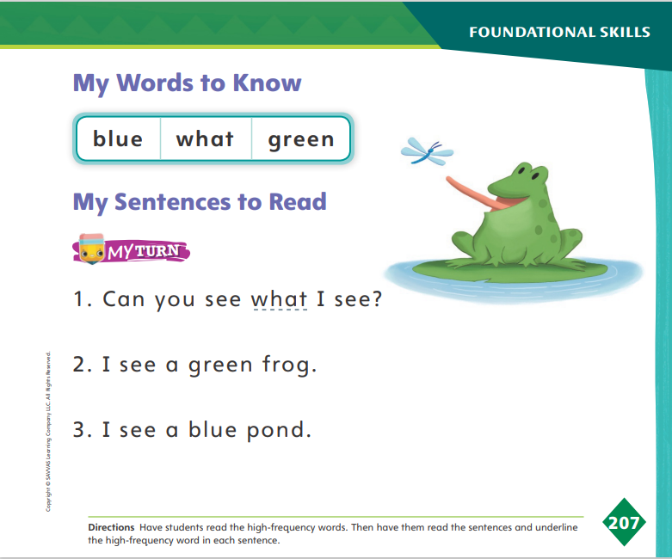
Page 207
High-Frequency Words
Turn to page 207 in your Student Interactive and complete the activity.
Notes:
Say: Today we will practice reading the high-frequency words blue, what, and green. Have students read the words at the top of p. 207 in the Student Interactive with you.
Have students look at the words at the top of p. 207. Say: I will read a word, and I want you to point to it. Then we will read the word together. Read blue, and have students point to it. Now let’s read the word together: blue. Repeat with the other words. Encourage students to use the words in sentences.
Have students read the sentences on p. 207 with you. Ask them to identify the words blue, what, and green in the sentences. Have them underline the high-frequency word in each sentence. Then have students read the sentences with a partner

Slide 24
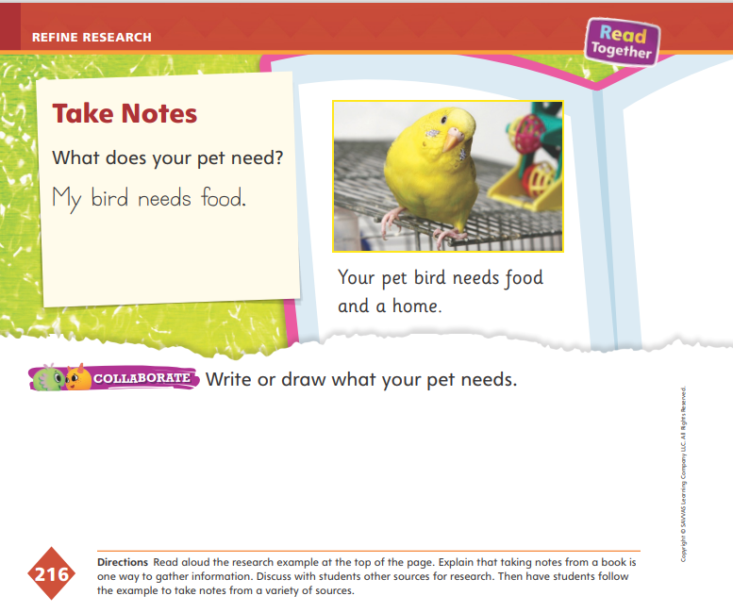
Page
216
Refine Research
Food
Needs
Home
Notes:
Students who learn how to take notes are able to recall more information and connect more learning than those who do not. Help students focus their note-taking skills by using a graphic organizer.
Draw a web graphic organizer on the board. In the center circle write “Needs.” Say: A web graphic organizer is a good way for me to organize my ideas. I know that I have to write about what my pet needs, so I am going to write “Needs” in the center circle. Can anyone guess what I might write in the circles around the “Needs” circle?
Allow student volunteers time to come up with words they would write. Have students turn to p. 216 in the Student Interactive. Say: Let’s look at the caption below the picture of the bird. It says, Your pet bird needs food and a home. Can anyone tell me what the bird needs? (food and a home) I am going to write “Food” in one circle and “Home” in another. Then I am going to draw a line connecting the circles.
Have student volunteers suggest two more needs for the bird pictured (Possible responses: cage, water, toys).
Have students draw a web graphic organizer and write what their pet needs. They should be able to come up with at least three needs. Point out that when they write these needs they are writing details about their pet.

Slide 25
Page
216
Refine Research
Turn to page 216 in your Student.
Write or draw what your pet needs.
Notes:
Explain that taking notes from a variety of sources is a way to gather information. Then have students take notes on their research project.
After they take notes, have them demonstrate their understanding of the information they gathered in their research by writing or drawing what their pet needs on p. 216 in the Student Interactive.
Next Steps: Have students begin writing or drawing their informational text. Allow them time to write their first draft, and encourage them to investigate and gather additional information about their pets if needed. For students who are further along in the writing process, meet with them in small groups to discuss their drafts.

Slide 26
Lesson 4

Slide 27

Phonics
-en
-et
get
pet
ten
pen
Notes:
Display Picture Card ten. Say: This is the number ten. The onset, or beginning sound, in ten is /t/. The beginning sound, /t/, is spelled with the letter t. The ending sounds in ten are /e/ /n/. The sounds /e/ /n/ are spelled with the letters en.
Hold up Picture Card pen, and say and spell the word. Words that end with the sounds /e/ /n/, and are spelled with the letters en, are in the same word family. So the words ten and pen are in the same word family.
Display the word get. This is the word get. It ends with the sounds /e/ /t/ and is spelled et. Another word in the /e/ /t/ word family is pet.
Display the letter combinations -en and -et on the board. Tell students that you will say words either in the -en or -et families. Tell them to listen carefully to the words and write in the air either et or en, depending on which ending sounds they hear in the word. Tell them that there will be one word that is not in the -en or -et families. Use the following words: vet, let, men, Ben, Ken, dip, pen, den, yet, set.

Slide 28
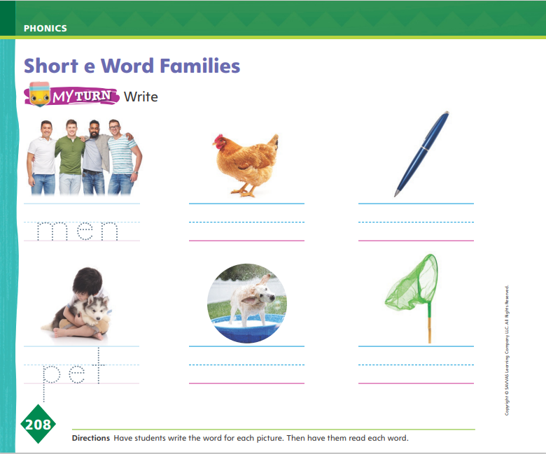
Page 208
Apply
Turn to page 208 in your Student Interactive and complete the activities.
Notes:
Have students identify each picture on p. 208 of the Student Interactive that belongs either to the -en or -et word family, and then have them write the words on the lines.
Ask students to identify the sounds of the letters that are different in each set of words.

Slide 29
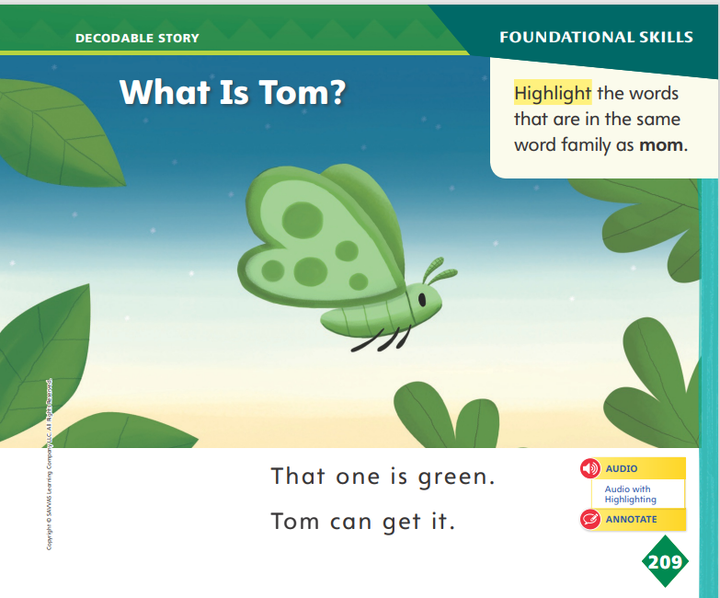
Page 209
Decodable Story
Turn to page 209 in your Student Interactive. Read “What is Tom?” with your partner.
Notes:
Have students turn to p. 209 in the Student Interactive. We are going to read a story today about a bat named Tom.
Point to the title of the story. The title of the story is What Is Tom? I hear the sound of short o in the word Tom. In this story, we will read words with the sounds of short o and short e.
Remind students of this week’s high-frequency words: blue, what, green. Tell them that they will practice reading these words in this story. Display the words. Have students read them with you. Say: When you see these words in the story, you will know how to identify and read them. You will also see some other Words to Know we’ve learned.
Have students whisper read the story as you listen in. Then have students reread the story page by page with a partner. Listen carefully as they use letter-sound relationships to decode. Have partners reread the story. This time the other student begins.
After students have read the story, call their attention to the title. I see the letter o in this word. What sound does the letter o make? Help them identify, or say, the sound /o/. Then have them locate and circle the words on p. 209 that are in the same word family as mom.

Slide 30
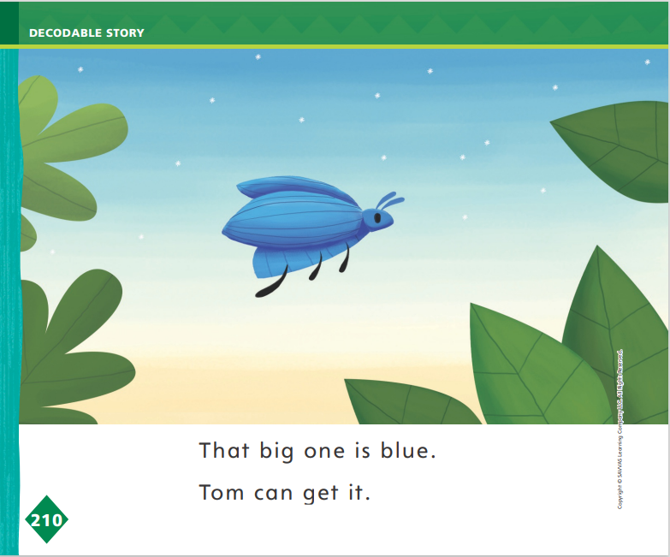
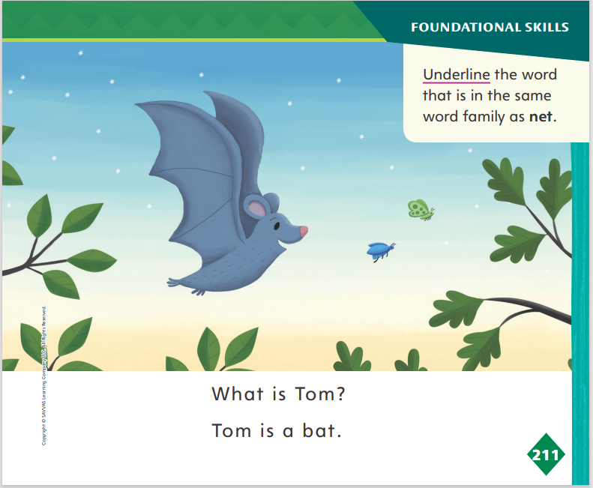
Page 210, 211
Decodable Story
Turn to pp. 210-211 in your Student Interactive. Read “What Is Tom?” with your partner.
Notes:
Have students turn to pp. 210–211.
Ask: Which word includes the sound /e/ and is in the same word family as net? Students should supply the word get. How do you know get is in the same word family as net? Students should say both words have the ending sounds /e/ /t/ spelled with the letters et, so they are in the -et family.
Have students underline the word get.

Slide 31
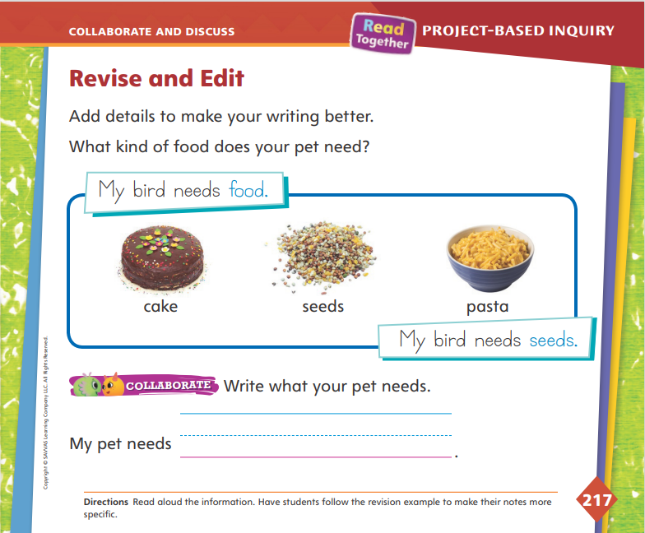
Page
217
Collaborate and Discuss
Turn to p. 217 in your Student Interactive and write what your pet needs.
Notes:
Remind groups to look back at their pet’s needs for opportunities to add more specific details. In the web graphic organizer, students may have written “food” as a need; however, students should try to revise their writing to be more specific. Use the Model and Practice to help students add details, either in the form of words or pictures, to their informational texts.
Direct students’ attention to the Revise and Edit page. Remind students that they had brainstormed needs of their pets, but that sometimes they can add specific details. Say: If I said that one of the needs for my pet is food, I am not being very specific. Looking at the photographs of a piece of cake, bird seeds, and pasta, I don’t think a bird would eat cake or pasta, but they are food. In this case, it would be better to be more specific about the type of food.
Have small groups evaluate their drafts. Ask guiding questions such as
Did we put details in our writing or drawing that show our pet’s needs?
Are each of our details as specific as we can get them?
If we put “home” as a need for a bird, how can we be more specific? (cage)
Have students write one specific need for their pet on p. 217 in the Student Interactive. Help students write or draw their details.

Slide 32

Apply
Add details to make your writing better.
Evaluate your first draft.
Write a clean, final copy of your informational text.
Notes:
Have students evaluate their first drafts. Distribute additional lined paper or drawing paper. Then have students create a clean final copy. Remind them to write their sentences neatly with enough space between each word. Point out that their drawings should include details about their pet.
Meet with small groups to review their final drafts. Prompt students to describe what they improved between drafts. Ask: Did you print more carefully in this draft? Did you include spaces between your words? What details did you add to improve your drawing? Accept student responses and point out the positive improvements in students’ final drafts.
For differentiated support”
If students struggle to identify how to improve their first drafts, guide them to review their drafts multiple times. During the first review, have students look at their letters.
Ask: Is my writing clear? Are the letters easy to read? If not, guide students to see that they need to revise their handwriting.
Next, ask: Did I leave enough space between my words? Can I read each word separately? If not, guide students to see that they need to add extra space between each word in their final drafts.
Finally, ask: Did I include enough details in my drawing? If not, guide students to see that they need to add more elements to their drawings.
Tell advanced students to add another detail to their writing. Ask: Is there another thing my pet needs? After students determine another detail, have them add it to their final drafts.
Next steps: Once students have a clean copy of their writing, have them take turns reading their papers to a partner. If students drew their responses, have them talk about their drawings. Tell students that tomorrow they will present their papers or drawings to the class. Then have students go back to the Pet Research Plan on p. 213 in the Student Interactive and check off “Draw and write about your pet.”

Slide 33
Lesson 5

Slide 34
Phonological Awareness
cot
dot
What other words rhyme with cot and dot?
den
What other words rhyme with den?
Notes:
Tell students that words that are in the same word family have the same middle and ending sounds. Remind them that words that have the same middle and ending sounds rhyme. Say: The words cot and dot are in the same word family. They rhyme because they have the same middle and ending sounds, /o/ /t/.
Tell students that there are other words that rhyme with the words cot and dot. What other words rhyme with cot and dot?
Have students generate as many rhyming words as they can. (Possible responses: got, hot, jot, lot, not, pot, rot) Then repeat the activity with den, guiding students to generate words that rhyme with den.

Slide 35
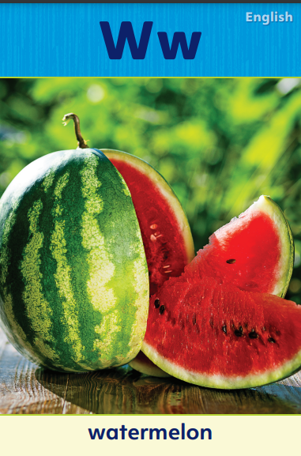

Phonics
Notes:
Tell students that today they will review two letters and their sounds from last week: consonants w and y.
Display the Alphabet Cards for Ww and Yy. Point to Alphabet Card Ww. W is the first letter in the word watermelon. The consonant w makes the sound /w/.
Then point to Alphabet Card Yy. The consonant y makes the sound /y/ when it is at the beginning of a word like yo-yo.
Have students review consonants w and y by saying words that contain these letters. Listen as I say the word wet: /w/ /e/ /t/. The word wet starts with the consonant w and has the sound of short e in the middle of the word. Now listen as I say the word yet: /y/ /e/ /t/. The word yet starts with the consonant y and has the sound of short e in the middle of the word.
In pairs, have students spell the words wet and yet aloud.

Slide 36
High-Frequency Words
blue
what
green
Notes:
Remind students that high frequency words are words that appear over and over in texts.
Say the word blue and ask students what letters spell the word.
Have students
say the letters as you write them on the board.
read the words aloud.
repeat with what and green.

Slide 37
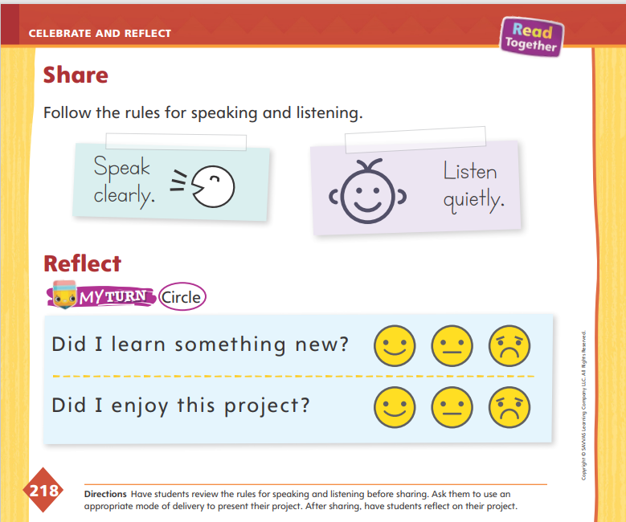
Page
218
Celebrate and Reflect
Turn to page 218 in your Student Interactive.
Present your informational text to your classmates as you follow the rules for speaking and listening.
Notes:
Tell students that today they will be sharing research projects about pets with the class. Have students find partners. Then give them time to practice presenting the results of their research projects to their partners in appropriate ways, such as speaking orally or displaying a piece of writing.
Have students ask their partners questions to understand information. Tell the presenters to speak audibly and clearly as they share their information and ideas and multi-word responses, such as complete sentences, to answer classmates’ questions.
Explain to them that in presenting the results of their research projects they should use an appropriate mode of presentation. One mode of presentation is oral (speaking); another is written. Tell students that presentations can also be multimedia, or a combination of media such as speaking, writing, and drawing. Then use the listening routine to help them understand how to be good audience members.
Active Listening Routine Regularly using routines will help strengthen students’ emotional, cognitive, and social development. Model the active listening routine to help students understand expectations when actively listening to their classmates to understand information.
Look - Look at the person who is talking. Do not talk. Listen actively.
Think - Think about what the person is saying.
Respond - Raise your hand when you have a question about information. Clap when the speaker is finished giving their multi-word response.

Slide 38
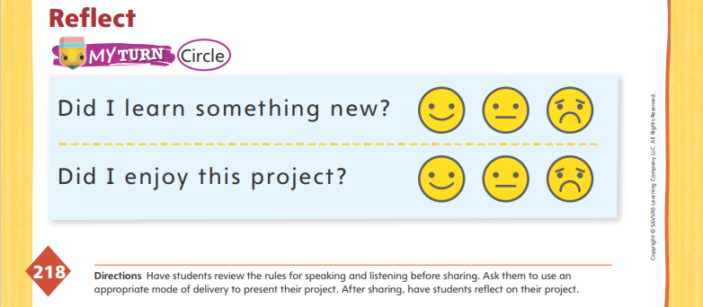
Page
218
Celebrate and Reflect
Turn to page 218 in your Student Interactive and complete the activity.
Notes:
Give students time to think about the steps they took to write about their pets. Guide students to think about how successful they were in their brainstorming, drafting, and revising.
Prompt reflection with questions, such as What did you do at the beginning of this project? in the middle? at the end? What did you learn about your pet during each part of the project?
Guide students to practice speaking audibly and clearly as they share information and ideas in the activity on p. 218 in the Student Interactive.

Slide 39
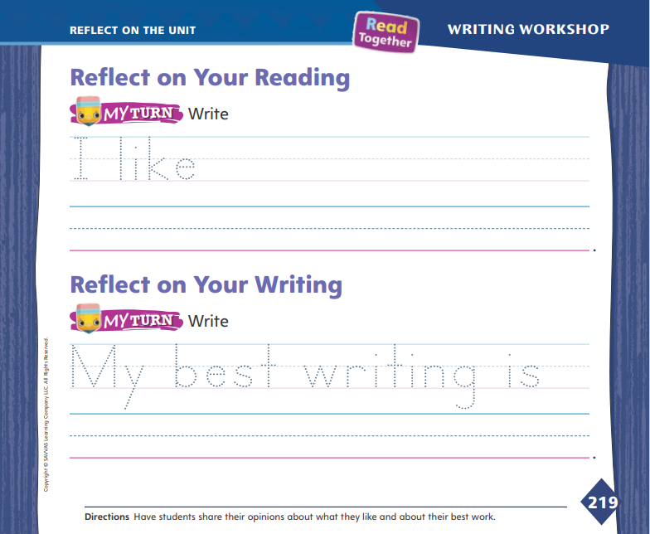
Page
219
Reflect on the Unit
Turn to p. 219 in your Student Interactive and complete the activities.
Notes:
Remind students of the Unit Goal: I can read informational texts. Remind them of the Essential Question: What do living things need? Consider these as you guide students to reflect on the reading and writing they did in this unit.
Look together at pp. 204–205 in the Student Interactive, and have student volunteers describe each reading selection shown there. The description should include the topic and a fact from the selection. Have other volunteers offer opinions of the selection, such as I liked reading about what animals eat or I like the pictures of animal mouths.
Ask students to identify what they learned about writing during this unit. Have volunteers share what they liked to write best. Encourage them to use sentence frames, such as I liked writing about _____. It was _____. or I liked drawing _____. It was _____.
Direct students to identify their favorite text from this unit and their best or most improved piece of writing. Guide them to trace the dotted letters under each Reflect activity on p. 219 in the Student Interactive and record their choices on the lines.

Slide 40
Unit 2: Week 6
Kindergarten

